Slide 1
University of Diyala Engineering College
Department of Communications Engineering
Electronics II : 3^{ed} Year - 2015/2016 By: Hussein Ahmed Mahmood
MULTISTAGE FREQUENCY EFFECTS
Most of a cascaded amplifier stages are used to obtain either voltage gain or a current gain. However, in most cascaded amplifiers, ultimately the power gain is important. If a voltage gain is required, we can calculate the total gain by using the equation for voltage gain of one stage. Thus, the voltage gain for stage l is:
In addition, the voltage gain for stage 2 is:
The gain for additional stages can be written in a similar manner. Then, the total amplifier voltage gain A_{total} for n-cascaded stages is:
Setting the magnitude of this result equal to 1/√2 (-3 dB level) results in

Slide 2
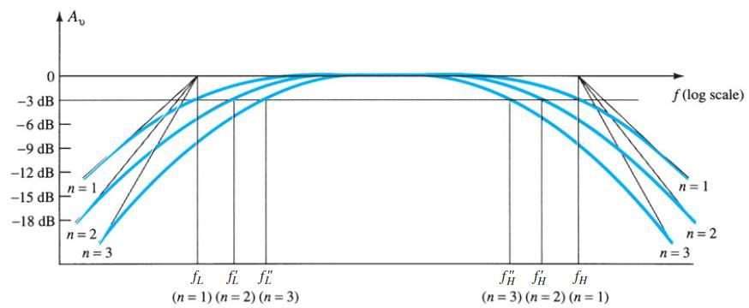
University of Diyala Engineering College
Department of Communications Engineering
Electronics II : 3^{ed} Year - 2015/2016 By: Hussein Ahmed Mahmood
so that
and
With the result that
In a similar manner, it can be shown that for the high-frequency region,
Fig.17
Effect of an increased number of stages on the cutoff frequencies and the bandwidth.

Slide 3
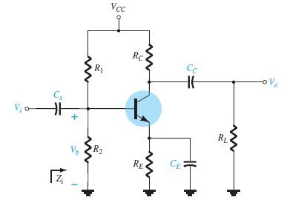
University of Diyala Engineering College
Department of Communications Engineering
Electronics II : 3^{ed} Year - 2015/2016 By: Hussein Ahmed Mahmood
Example (1): Determine the cutoff frequencies for the network of fig.1. using the following parameters : C_{S} = 10µf , C_{E} = 20µf , C_{C} = 1µf , R₁ = 40kΩ , R₂ = 10kΩ , R_{E} = 2kΩ , R_{C} = 4kΩ , R_{L} = 2.2kΩ , β = 100 , V_{CC} = 20v , r_{o} = ∞Ω ?
Solution: The dc base voltage is determined by:
( )
( )
Fig.1
The Midband Gain of the system is determined by:
( ) ( )
For C_{s}
( )( )( )

Slide 4
University of Diyala Engineering College
Department of Communications Engineering
Electronics II : 3^{ed} Year - 2015/2016 By: Hussein Ahmed Mahmood
For C_{c}
( )
( )( )( )
For C_{E}
(
)
(
)
(
)
( )
( )( )( )
Since f_{LE} >> f_{LC} or f_{LS} the bypass capacitor C_{E} is determining the lower cutoff frequ- ency of the amplifier.

Slide 5
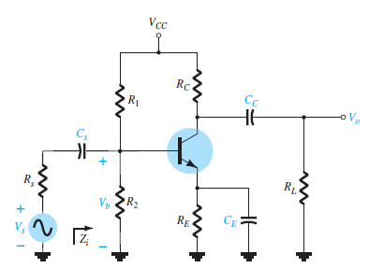
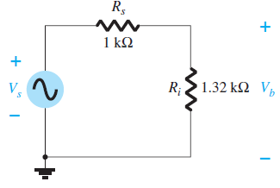
University of Diyala Engineering College
Department of Communications Engineering
Electronics II : 3^{ed} Year - 2015/2016 By: Hussein Ahmed Mahmood
Example (2): Determine the cutoff frequencies for the network of fig.2. using the following parameters : C_{S} = 10µf , C_{E} = 20µf , C_{C} = 1µf , R_{S} = 1kΩ, R₁ = 40kΩ , R₂ = 10kΩ , R_{E} = 2kΩ , R_{C} = 4kΩ , R_{L} = 2.2kΩ , β = 100 , V_{CC} = 20v , r_{o} = ∞Ω ?
Solution: The dc base voltage is determined by:
( )
( )
The Midband Gain of the system is determined by:
Fig.2
( ) ( )
( )( )

Slide 6
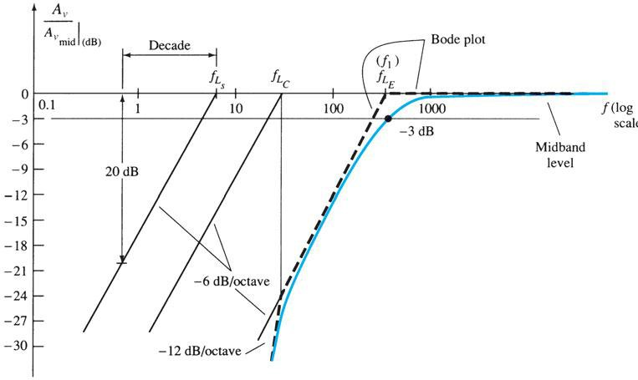
University of Diyala Engineering College
Department of Communications Engineering
Electronics II : 3^{ed} Year - 2015/2016 By: Hussein Ahmed Mahmood
For C_{s}
( ) ( )( )( )
For C_{c}
( )( )( )
( )
For C_{E}
( )
(
) ( ) ( )
( )( )( )

